Slide 1
Case Study: Product returns prediction
Teleperformance

Slide 2
Problem Statement
Return shipping is expensive for online platforms and return orders are said to reach 50% for certain industries and products.
Free or inexpensive return shipping has become a customer expectation and de-facto standard in the fierce online competition on clothing.
Shops have indirect ways to influence customer purchase behaviour.
For purchases where return seems likely, a shop could, for example, restrict payment options or display additional marketing communication.

Slide 3
Introduction & Overview
The purpose of this case study is to analyze the provided data regarding historical purchase decisions of online shop users.
How to handle the large-scale data sets involved in this problem
Which machine learning prediction model would be used
Use machine learning techniques on it and based on this predict if customer is likely to return the item in the future or not.
Accurate prediction of product returns allows organization to prevent problematic transactions in advance.

Slide 4
Dataset
The data consists of thirteen fields with user decision.
There are few data fields which may play significant role in decision making such as price, item size, item color, and user title, etc.
The dataset also consists of three ids such as order id\item id\user id which seems to be less informative to the prediction model.
After checking all the data there are suspicious dates for which delivery date is less than order date.

Slide 5
Data preparation
The new important fields are created which contain relevant information and model could benefit from it are as follows:
Age: age of user at order time is crucial information which is computed from DOB (date of birth) on the date of order.
Delivery time: one of the important fields is the delivery time which can be computed from date of order to date of delivery.
Register user time: how long user is a registered member is also a significant factor which can be found from user registration date to order date.

Slide 6
Data preparation
New fields regarding dates: New variables are generated from date fields, which later can turn out to be useful such as day, month and year.
Categorical data field: It can be assumed that item size and color are important factors for customers; both can play a crucial role in decision making. For both the variables, one hot encoded and numerical category encoding techniques are used.

Slide 7
Feature selection
some of the variables may not be much relevant or less informative.
Irrelevant variables or correlated variables could deteriorate the performance of classifier.
Large number of input variables also leads to increase in the computational cost and risk of over-fitting as well as noise.
Permutation feature importance technique is used to transform the feature space from higher dimension to lower dimension by removing redundant and highly correlated variables from feature space.

Slide 8
Permutation feature importance technique
Permutation feature importance technique (PM) using Random Forest is used as the feature selection model to find the feature relevance score, due to its robustness.
This method will randomly shuffle each feature and compute the change in the model’s performance.
The features which impact the performance the most are considered to be the most important one.
This technique is useful for non-linear or opaque estimators.
This technique benefits the model from being agnostic.

Slide 9
Prediction models selection
The models used for predicting the data are
Random forest
Support Vector Machine (SVM)
Xgboost
The feature selection model is fitted on the training dataset to find the feature relevant score.
The features are selected based on the criteria: feature score> threshold.
The optimal feature subset is passed to prediction models.

Slide 10
Results & Observation
Three categorical variables- item size, item color, user title are encoded by using two techniques:
One hot encoded technique
numerical category encoding technique
To train and fine tune the parameters, the dataset is partitioned into 60:40 ratio.
60 percent data samples are used to train and fine tune the model while 40 percent samples are used to evaluate the performance of prediction models.

Slide 11
One hot encoded technique
Dummy variables are created for item size, item color, and user title and created an input vector of size 203.
The important features are selected based on the criteria i.e., feature score> 0.
AUC (%) | Random forest | XGboost | SVM
With PM | 68.54 | 68.35 | 63.56
Without PM | 66.45 | 67.85 | 62.74

Slide 12
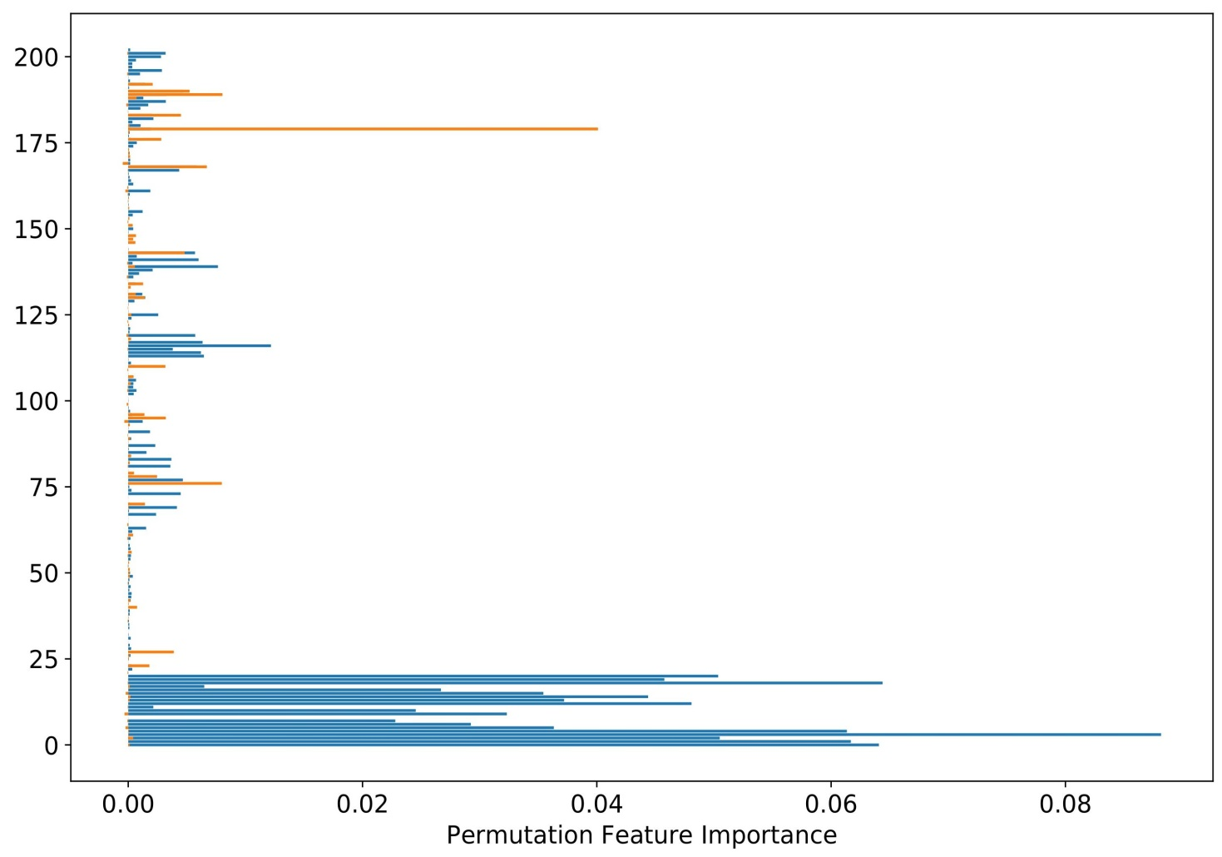
Permutation feature importance

Slide 13
Numerical category encoding technique
Numerical categories are created for item size, item color, and user title and created an input vector of size 24.
21 features are used to predict the user decision.
AUC (%) | Random forest | XGboost | SVM
With PM | 73.18 | 74.29 | 67.03
Without PM | 66.54 | 68.85 | 63.42

Slide 14
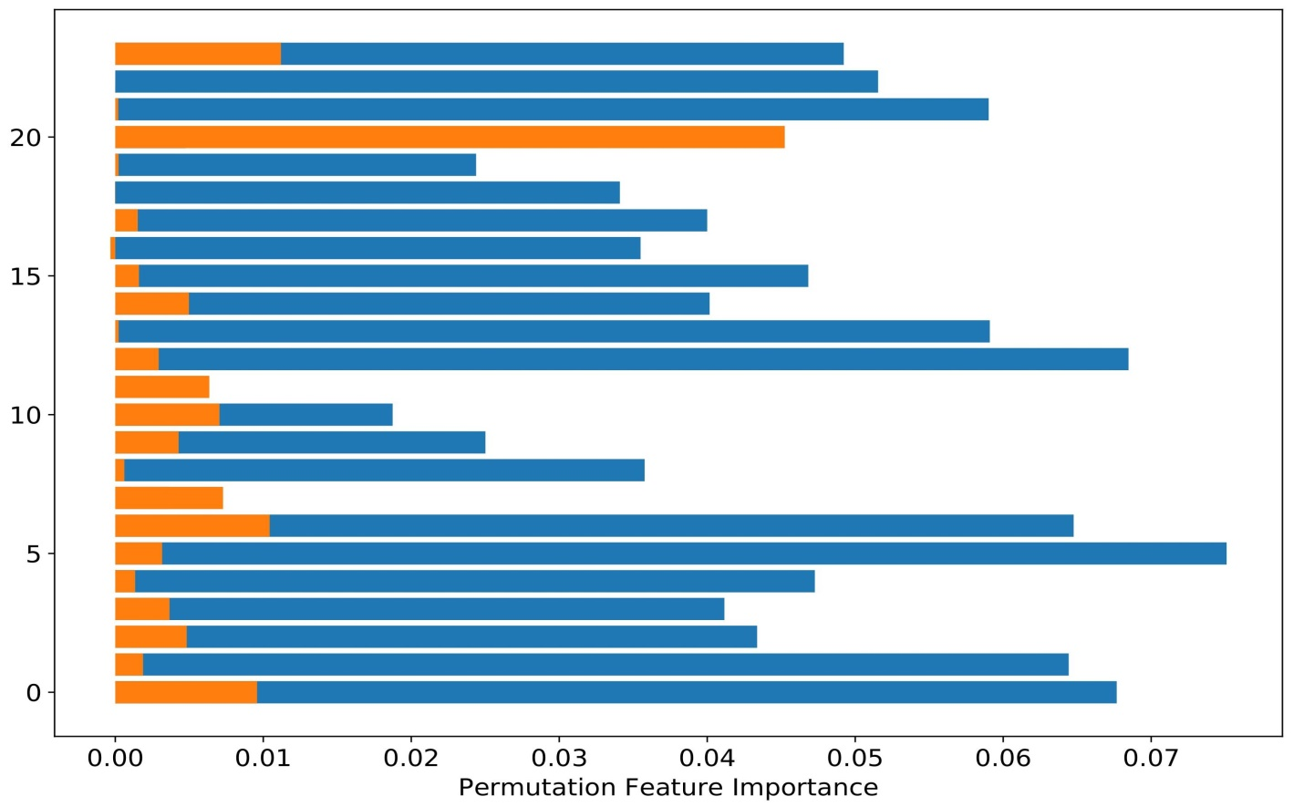
Permutation feature importance

Slide 15
Summary
Real situation into consideration could have been a great help, as people most of the times have direct affection to the specific brand and specific item.
Inconsistency between dates need to be resolved, e.g., delivery date is less than order date.
The model achieved the accuracy of 74%.
Despite the fact that there is scope for improvement.
Preliminary findings suggest that the ML models are capable to predict the user decision.

Slide 16
THANK YOU

